Slide 1

DATA Report
FOR Scotland Cancer mortality
DATA ANALYSIS Project
ميم سين

Slide 2
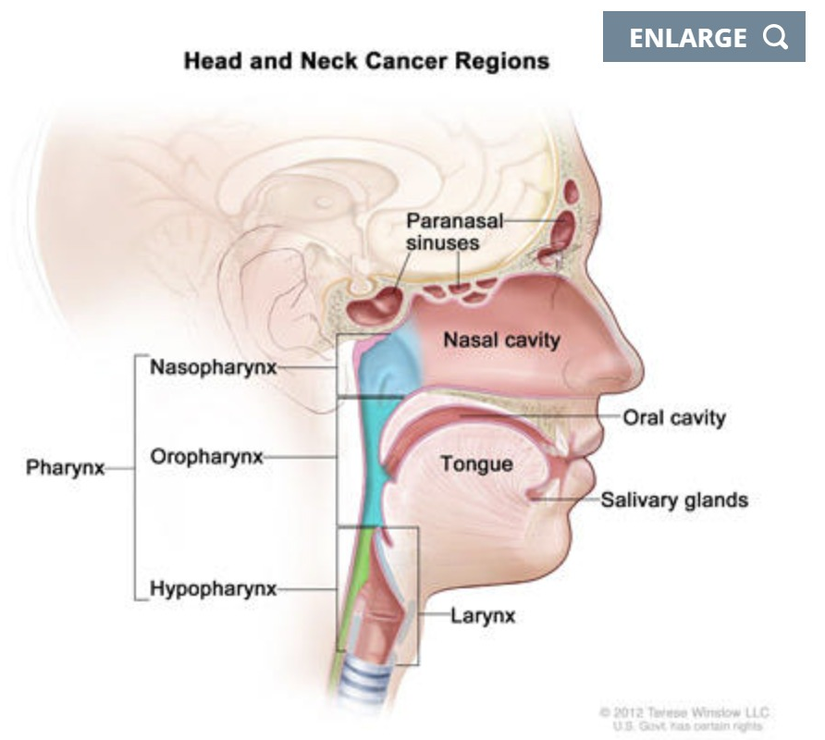
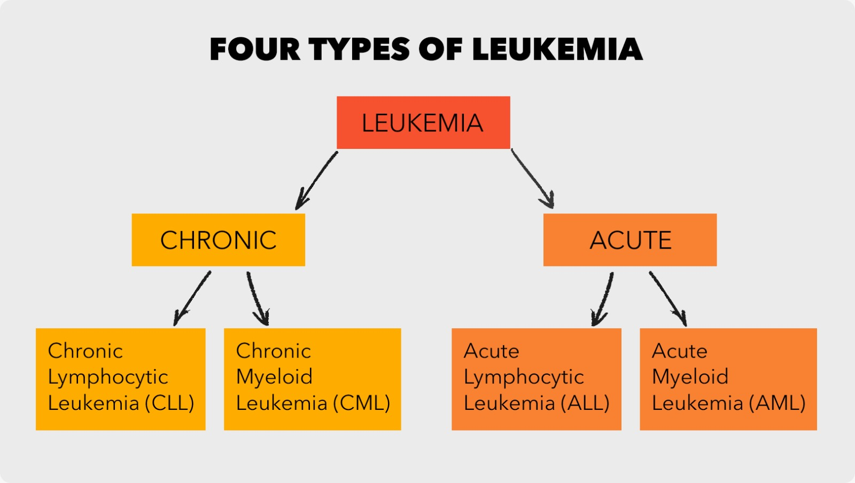
Head and neck
Larynx
Lip, oral cavity and pharynx
Mouth (IARC definition)
Oral cavity
Salivary glands
Thyroid
Tongue
Oropharyngeal cancers
Head and neck
Leukemias
Acute lymphoblastic leukaemia
Acute myeloid leukaemia
Chronic lymphocytic leukaemia
Chronic myeloid leukaemia
Leukemias
ميم سين

Slide 3
Bone and articular cartilage
Bone and connective tissue
Connective tissue
Bone and connective tissue and articular cartilage
Malignant brain cancer
Malig brain
Malignant brain
Colorectal cancer
Colon
Rectum and rectosigmoid junction
Rectum and rectosigmoid junction
Cervix uteri
Corpus uteri
Ovary
Uterus
Vagina
Vulva
Uterus
ميم سين

Slide 4
Common Type
Trachea, bronchus and lung Cancer
ميم سين

Slide 5
Lowest Mortality Rate
Total Deaths
Highest Mortality Rate
1998
839238
2019
ميم سين

Slide 6
Population Inc AVG
0.27%
ميم سين

Slide 7
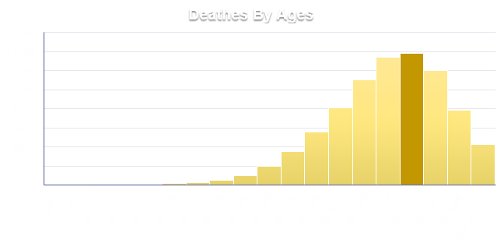
Highest Mortality Rate
interval
75 to 79
ميم سين

Slide 8
ميم سين

Slide 9
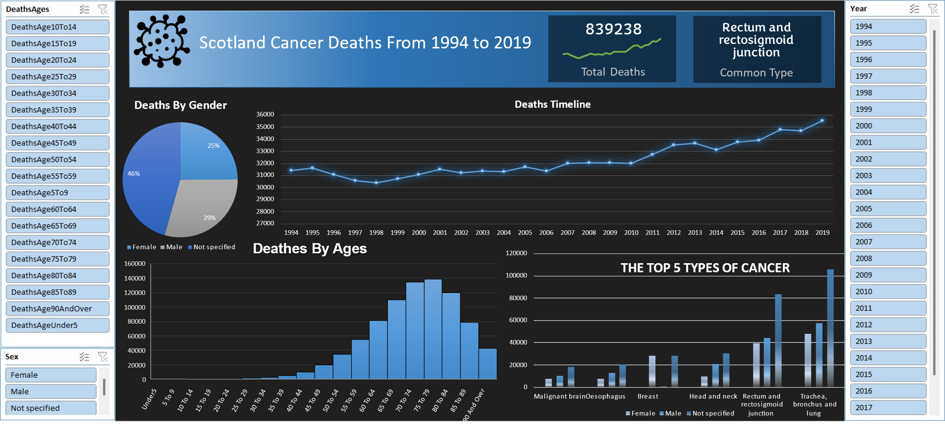
ميم سين

Slide 10
Highest Mortality Rate
interval
70 to 74
ميم سين

Slide 11
Lowest Mortality Rate
Total Deaths
Highest Mortality Rate
2003
211,300
1994
ميم سين

Slide 12
ميم سين

Slide 13
Lowest Mortality Rate
Total Deaths
Highest Mortality Rate
1994
138,310
2019
ميم سين

Slide 14
Common Type
Malignant brain
ميم سين

Slide 15



End
of
Text …
ميم سين

